Slide 1
Welcome to Web World
🕸🗺

Slide 2
What is a website?

Slide 3
https://chiaski.github.io/art369/exercises/WORLD.html

Slide 4
What websites have you visited?

Slide 5
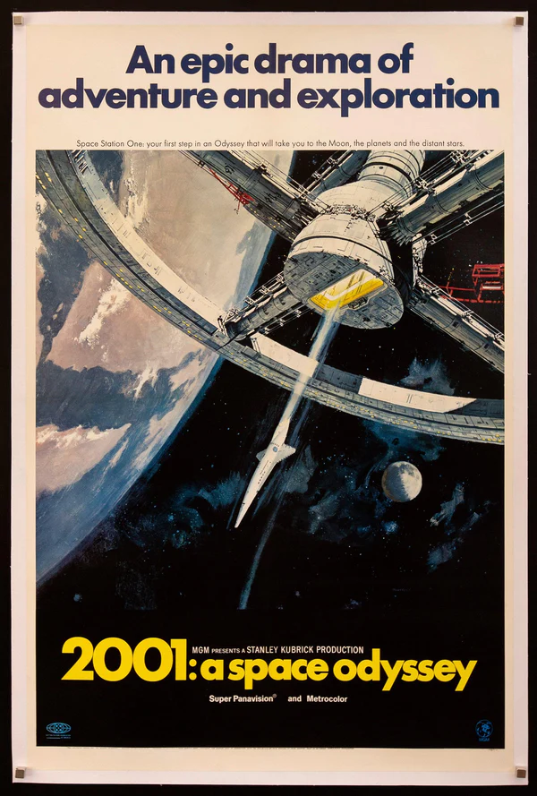
one example: Wikipedia
open Google Chrome
visit a page for a movie like 2001: A Space Odyssey
right click and select the Inspect option*
look at the HTML code that powers the site!
*Hack Heist Hint
Notes:
Let’s take a look at an example. Has anyone been to Wikipedia before? We are going to visit a Wikipedia page, and take a look at the code that builds it. Can anyone name a movie?
Go to the Wikipedia page for a movie (or TV show, or music artist, or anything else), and follow the instructions on the slide. When viewing the source, explain that all the text is HTML code, and that the web browser (Google Chrome) interprets the code and makes it into a nice website. More info on the next slide.

Slide 6
HTML
HTML stands for HyperText Markup Language.
you can use HTML to build websites.
web browsers (like Google Chrome) take an HTML document and turn it into a nice looking page.
Notes:
Does anyone know what HTML is? Click.
It stands for HyperText Markup Language. Click.
You can use it to build websites. Click.
As we saw, web browsers like Chrome take all that garbled mess of code and turn it into a nice looking website!

Slide 7
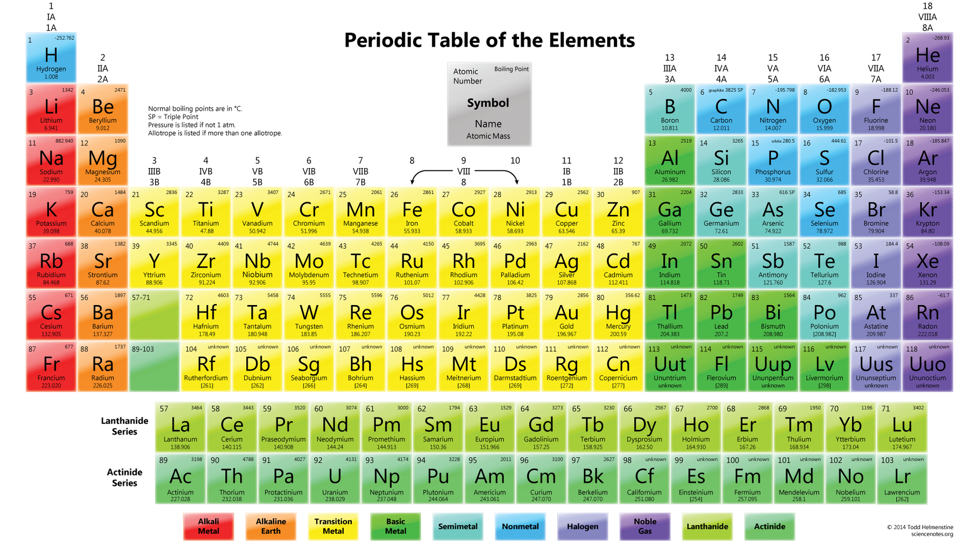
Elements
just as everything in our world is made up of the chemical elements,
everything in the web world is made up of
HTML Elements
Notes:
Now let’s talk a bit about HTML elements. Can anyone tell me something you’ve seen on a website before? Click.
Some examples are text, links, pictures, and videos. Click.
All of these things are examples of HTML elements. Elements are the building blocks of a website, and we will learn how to use some different ones to create different components on a site.

Slide 8

HTML Elements
what’s something you’ve seen on a website?
text
pictures
every little thing on a website is an HTML element.
links
videos
Notes:
Now let’s talk a bit about HTML elements. Can anyone tell me something you’ve seen on a website before? Click.
Some examples are text, links, pictures, and videos. Click.
All of these things are examples of HTML elements. Elements are the building blocks of a website, and we will learn how to use some different ones to create different components on a site.

Slide 9
Our First HTML Element: A Header
<h1>Mel’s Website</h1>
< and >
Less-than and Greater-than signs
A.K.A.
Angle Brackets
Alligators
Pac Mans
<h1>
Opening tag for the element
A.K.A.
Tells HTML to start a big header element
Content
That which is to be enclosed within the HTML element
A.K.A.
The stuff inside the thing
</h1>
Closing tag for the element
A.K.A.
Tells HTML to end the big header element

Slide 10

CSS Style
CSS is a language that lets you customize styles.
it stands for Cascading Stylesheets.
you can change things like colors, fonts, and sizing.
if HTML is the body of a website, CSS is the clothing that it wears
Notes:
We are also going to use CSS to add style to our websites. Click.
CSS is a language that lets you customize styles. Click.
It stands for Cascading Stylesheets. Click.
You can change the appearance of almost anything on your website, including colors, fonts, and sizing. Click.
If HTML is the body of a website, CSS is kind of like the clothing it wears - it won’t change the actual content, but it can change how it is presented.

Slide 11
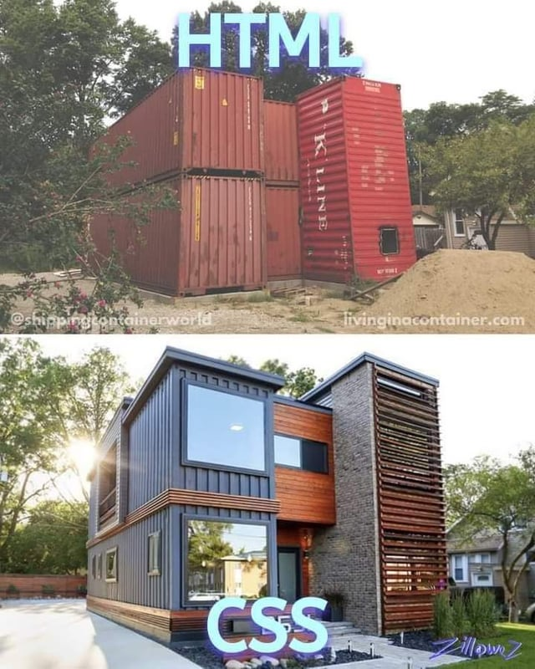

Slide 12

JavaScript Logic
HTML is the body.
CSS is the clothing.
JavaScript is the brain.
JavaScript lets you create dynamic, interactive experiences on the web
Notes:
We are also going to use CSS to add style to our websites. Click.
CSS is a language that lets you customize styles. Click.
It stands for Cascading Stylesheets. Click.
You can change the appearance of almost anything on your website, including colors, fonts, and sizing. Click.
If HTML is the body of a website, CSS is kind of like the clothing it wears - it won’t change the actual content, but it can change how it is presented.

Slide 13

The friendly community where everyone builds the web
Notes:
We are going to code using Glitch. It let’s you write code for websites and share them across the web! Click.
Glitch is known as the friendly community where everyone builds the web. Let’s take a look.

Slide 14
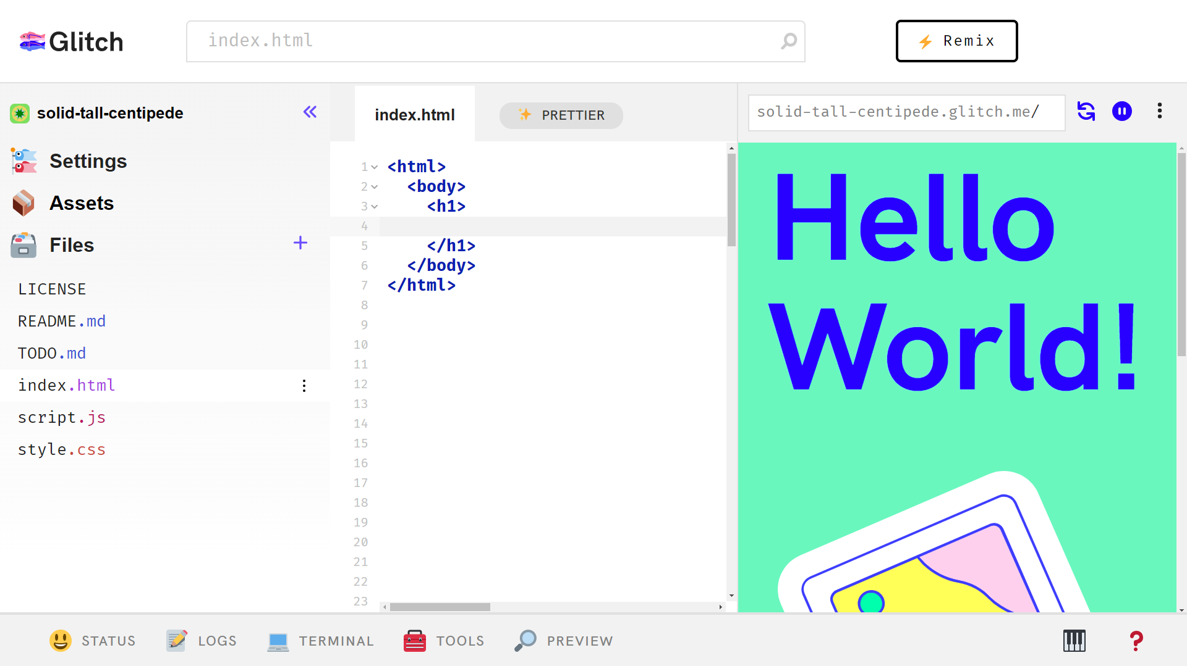
Update preview
Manage files
Write code
Glitch Overview
Open preview
Preview the site
Notes:
A Glitch project consists of a few different parts. First, there’s the code editor. Click.
This is where you can write the code for your website. It’s right in the middle of the page. But where does the actual site go? Well, we need to preview it! Click.
Clicking the PREVIEW button with the magnifying glass will allow you to preview the site you’re building. Click.
The preview shows up on the right! Click.
On the left, there’s the file management pane – this is your folder where you can swap files and add more. Click.
Finally, there’s the Refresh button at the top of the preview – that’s how you update your preview so it uses your latest code.

Slide 15

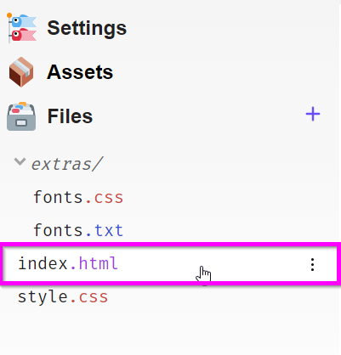
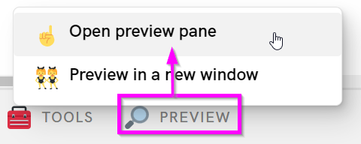
Instructions
1) open a web browser like Chrome or Edge
2) go to bit.ly/wws25
3) open the index.html file (left)
4) open the preview pane (bottom)
Notes:
Have the students log into their computers - depending on the room, they may already be logged in. Otherwise, make sure to write the log-in information on the whiteboard.
They should follow these instructions to open the starter web project. StackBlitz can be a little glitchy, but once they’ve forked and saved, they should be able to see the updates. They may need to save multiple times for it to work.
From there, start walking through the activity: https://hylandtechoutreach.github.io/coding-activities/HtmlCssLesson.html

Slide 16
Possibilities & Resources
hackyland.github.io

Slide 17
Customization
hackyland.github.io

Slide 18
Blooket

Slide 19
Anything is possible on the web!

